Slide 1

ADVANCED IOT AND DATA-DRIVEN SOLUTIONS
FOR OPTIMIZING VEHICLE LIFECYCLI
MANAGEMENT AND MAINTANANCE
P r oj e c t I D :
24 -2 5j - 1 72

Slide 2










Te
Mr.NeIum
Supervisor
Miss.Akshi de
silwa
Co- Supervisor
Nafeel SM Leader
Shukri HM
Member
Ahlaan MI
Member
Nanayakkara
G.P.D.P
Member

Slide 3


Jntroduction
The automotive industry is evolving with IoT and AI technologies.
Accurate vehicle tracking remains a critical challenge.
Predictive maintenance is needed to reduce downtime.
Personalized vehicle advice can enhance user satisfaction.
Effective parts recommendations require better data analysis.

Slide 4
Research Problem
How can we accurately track and log the total lifetime travel of vehicles using loT technology?
How can predictive maintenance be effectively scheduled using real-time sensor data and time series analysis?
How can we provide real-time, personalized vehicle advice
through a neural network-based chatbot?
How can customer reviews be leveraged to provide personalized and reliable recommendations for automobile parts?

Slide 5


Litrature Review
The integration of loT and data-driven technologies is reshaping the automotive industry, particularly in the realm of vehicle lifecycle
management and maintenance. This literature review explores the key areas of IoT-enabled vehicle track & log (km), predictive maintenance, neural network-based vehicle advisory systems, and personalized automobile part recommendations.

Slide 6

Conclution
The reviewed literature underscores the transformative potential of loT and data-driven solutions in vehicle lifecycle management. By integrating real-time data analytics, predictive maintenance, Al-driven advisory systems, and personalized recommendations, the automotive industry can achieve greater efficiency, reduced operational costs, and enhanced customer satisfaction. Future research should continue to explore the optimization of these technologies to further advance vehicle lifecycle management and maintenance.

Slide 7

Objective
Enhance vehicle lifecycle management by using IoT and AI technologies to optimize usage, reduce downtime, and provide personalized advice and parts recommendations.

Slide 8
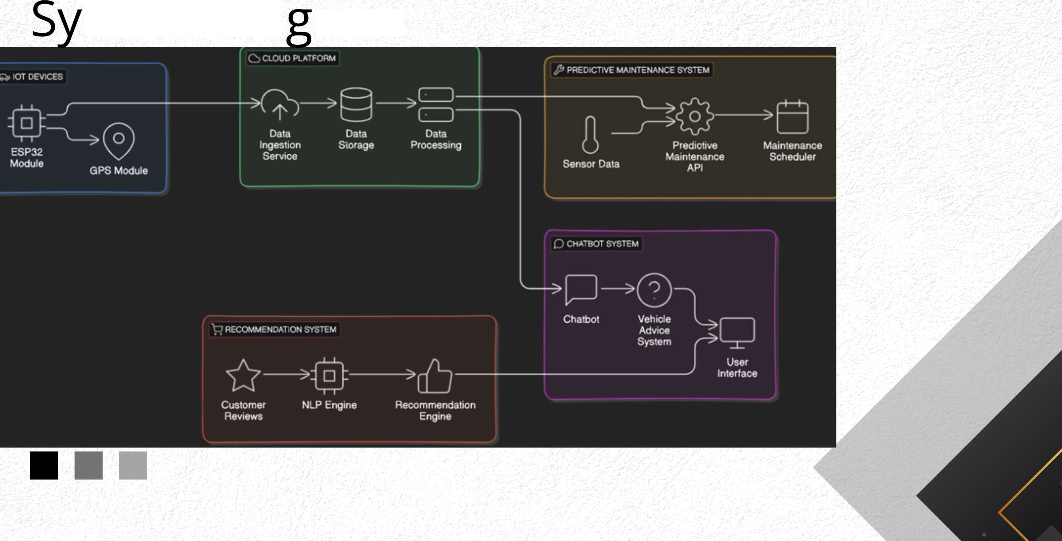
stem Dia ram

Slide 9




Component
ACCURATELY TRACK AND LOG VEHICLE
TRAVEL MAP
Nafeel SM

Slide 10


Objective
The primary objective of this function is to develop a comprehensive and cost-effective vehicle tracking system utilizing ESP32 module for real-time GPS monitoring.
Aims to detect total lifetime travel history of the vehicle
Analys future trevel movment of a vehicle based on previous data.
Nafeel SM - iT21 173554

Slide 11

























ow can we utilize loT
technology to Accurate track
”
e
an log the Com fete Travel isto of ve icles on a ma
Nafeel

Slide 12
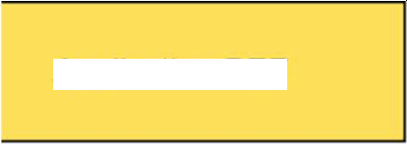
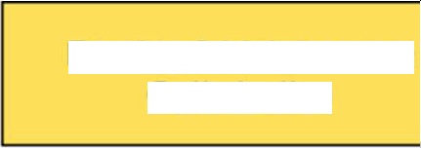




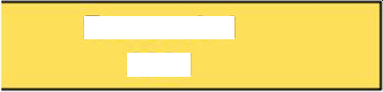
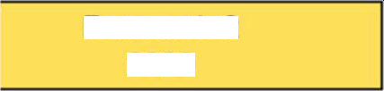




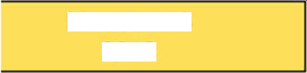



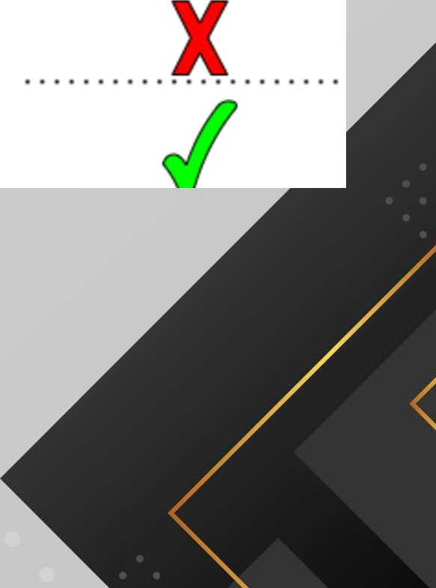






Research Gap
Real-Time Travel PaRern
Analysis
CDud Da@ TRnsmission
Routing & tdaintenance
Optimoatan
Applicat1on REF
Research 1
2021
Research 2
2020
Research 3
2018
Proposed System
Nafeel SM

Slide 13














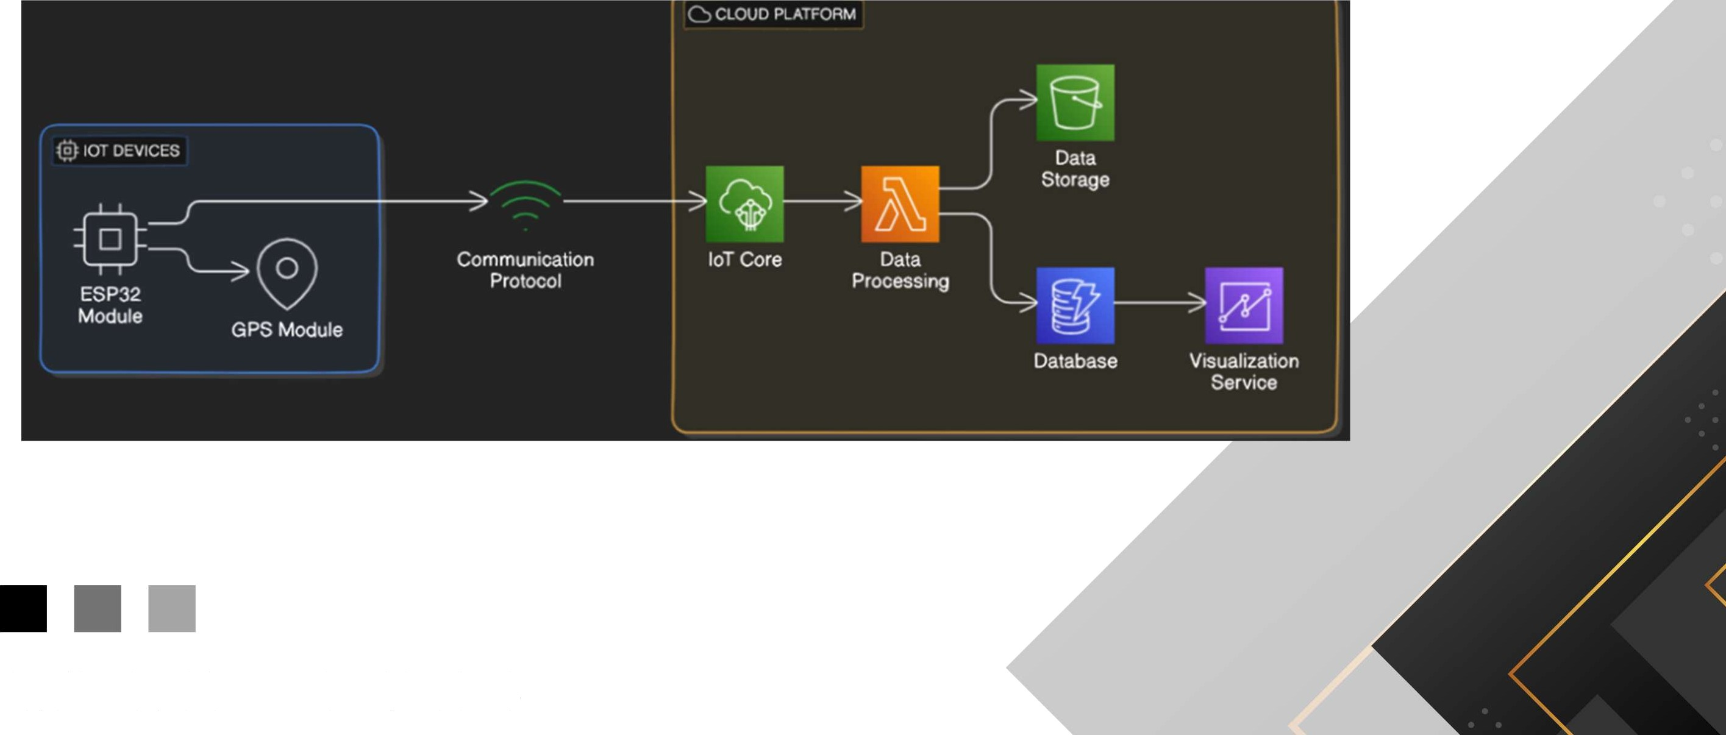
e I
Nafeel SM - iT21173554

Slide 14
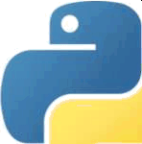

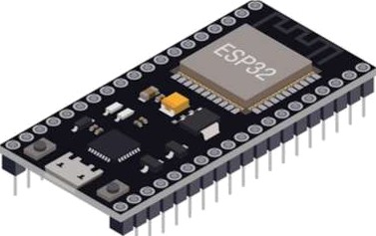

Technoiogies
Generai Environment
Python
Googie APi
FireBase
MAP
Toois
GPS
ESP32 Moduie
Nafeel SM

Slide 15








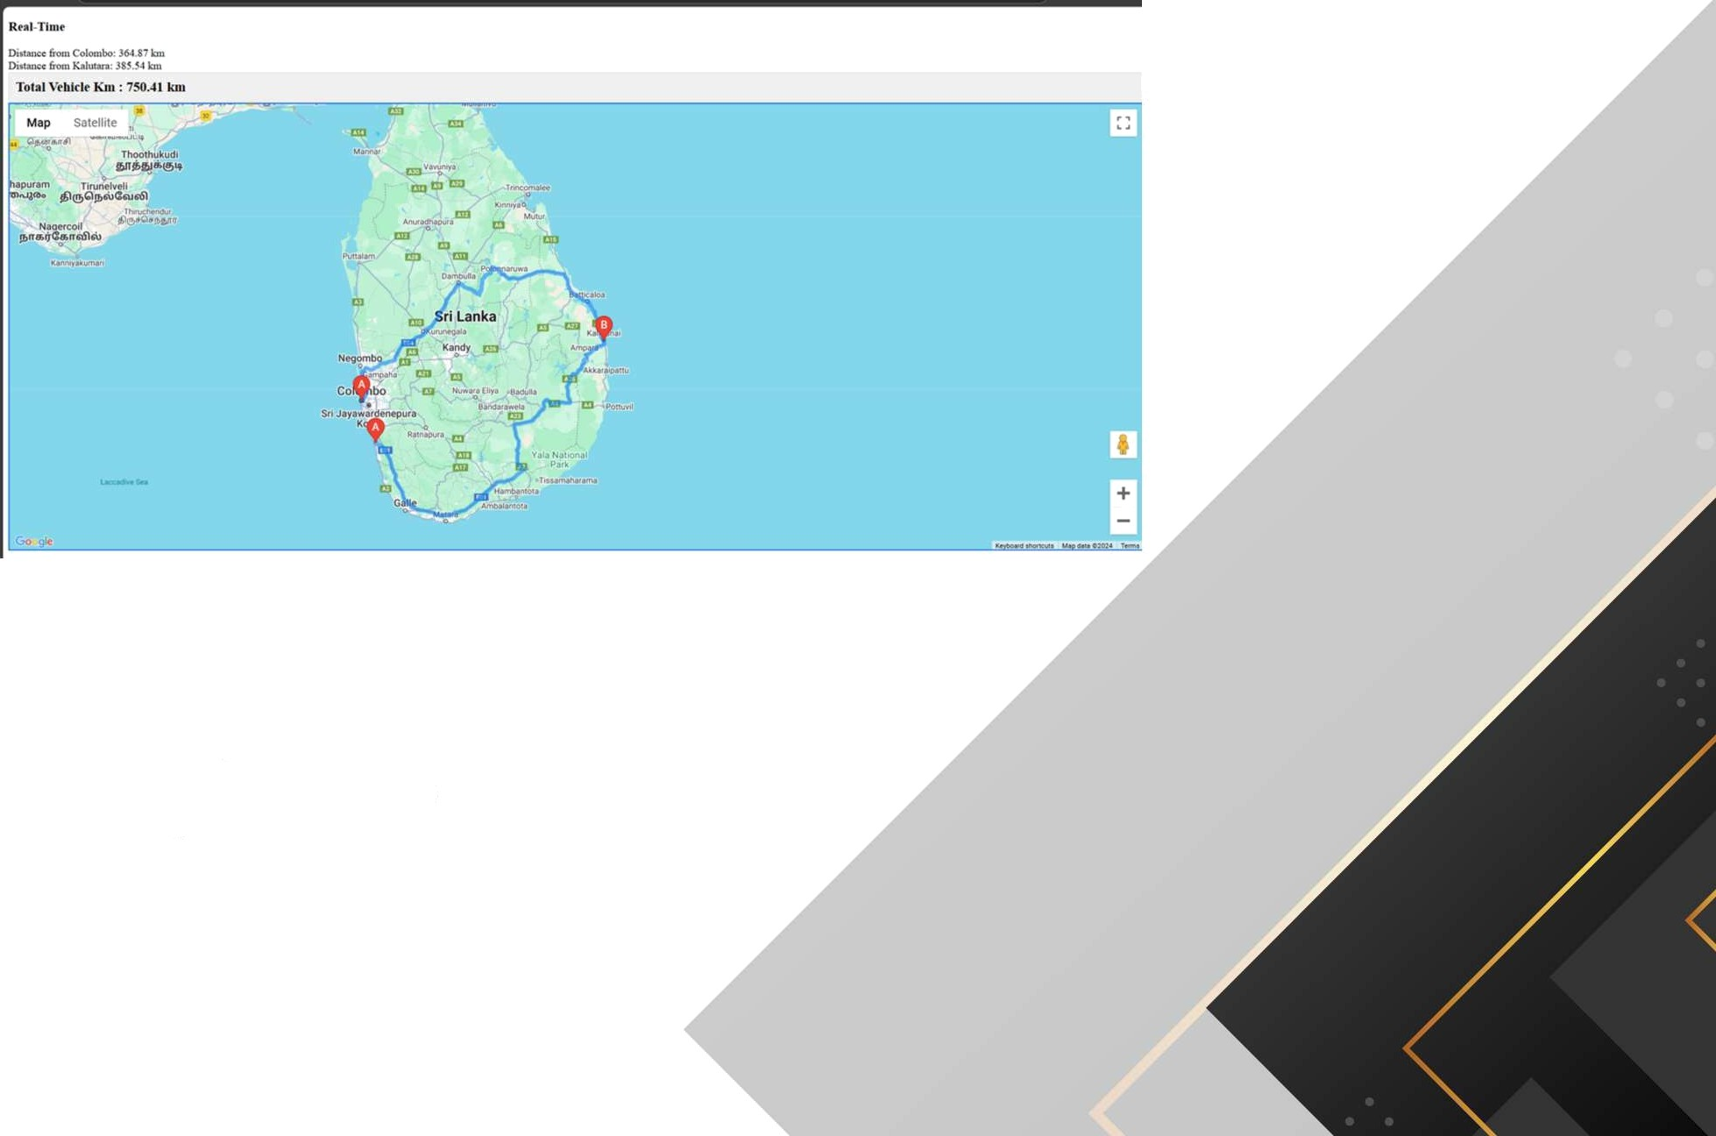
Jeti
WO
Track Vehicies with
GPS
View Treveled data KMs with places through map.
Calculate real-time KM one place to
another place
Nafeel SM - iT2J 173554

Slide 16


Future Checklist
To forecast the vehicle distance in Kelometers for the next month or year based on the previous month or year data
Generate all the vehicle history
data in a graph
Nafeel SM

Slide 17


om onen
Diagnostics Schedule predictive
maintenance
Shukri H.M

Slide 18


















rc
ow can
effective
redictive maintenance be
sc eduled using real-time
sensor ata an time series analysis?

Slide 19










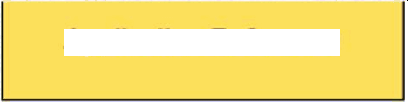
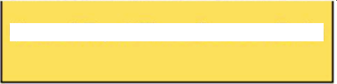
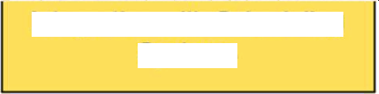
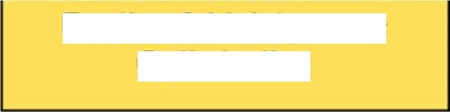











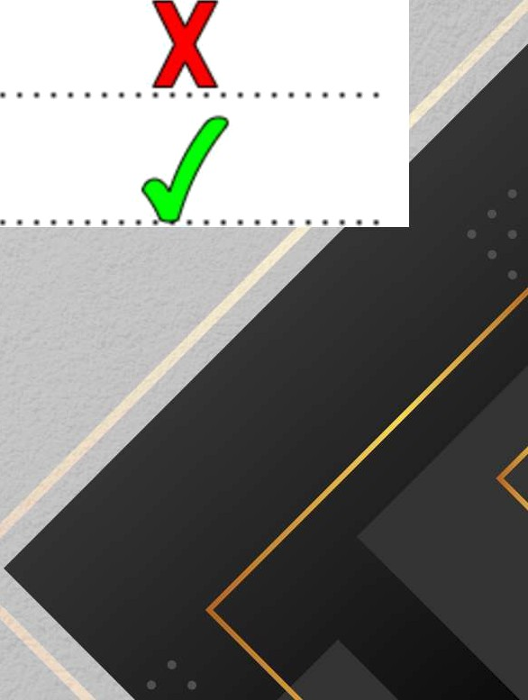




Application Reference
Use of Real-Time Sensor Data
implementation of Predective Maintanane Models
Integration with Scheduling Systems
Routing & Maintenance
Optimization
Anew archâecture of collaborative vehicies for monitoring fleet health
iOT Based Pze‹Fx ve Maintenance Using LSTM
RNN Estd nator
Predictive analytics as a sewioe for vehste
healiñ monitodoq using edge computing andAK-
NN aborithm
,
Proposed System

Slide 20
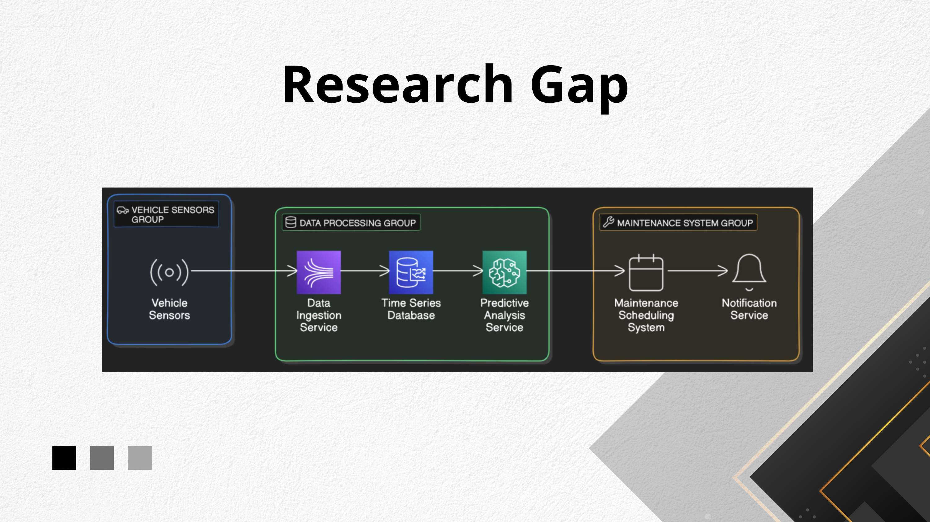

Slide 21


ec
IoT Devices: Sensors (tempers
Machine Learning Algorithms:
Analysis Techniques: Time Ser
Cloud Computing: Scalable st‹
Data Analytics Tools: TensorFl
Embedded Systems: Microcor
Communication Protocols: M(
Development Tools: Arduino I

Slide 22
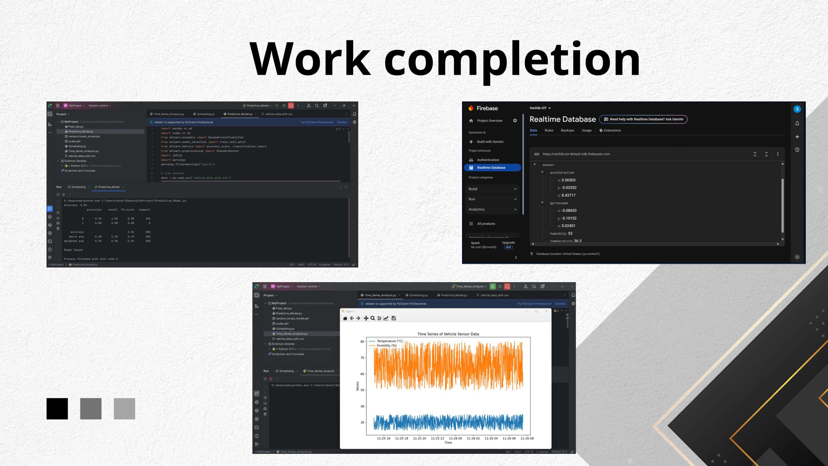

Slide 23


Future Checkİist
Setup all data into Firebase
Ui desings

Slide 24

Component
NLP and Neural Networks for
Personalized Vehicle Recommendations
Ahlaan Mi

Slide 25





esearc em
How can we provide real-time, personalized vehicle advice through a neural network-based chatbot?
=,
*

Slide 26



Objective
Develop an intelligent chatbot system using neural networks to provide real-time, personalized vehicle advice, enhancing user decision-making and satisfaction.

Slide 27

















Research Gap
Neural network-based
Application Reference
Basic vehicle advice | Al-driven chat&ts, | Chatbots wéh static
systems wlhout AI or | but lacking real-time | responses, no neural
real-time adjustments | vehicle advice | network integration
chatbot providing real'-
time, personalized
vehide advice.
Research A
Research B Research C Proposed system

Slide 28





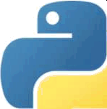

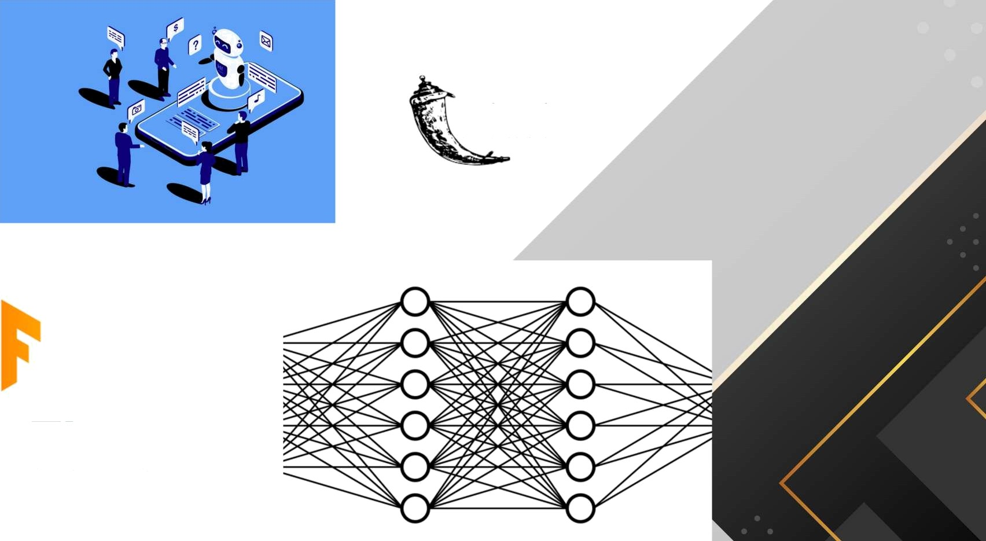

Te iogi
Python
PyCharm
TensorFÍow
flask
NLP
Neuraİ network
Gİthub
Flask
TensorFlow

Slide 29
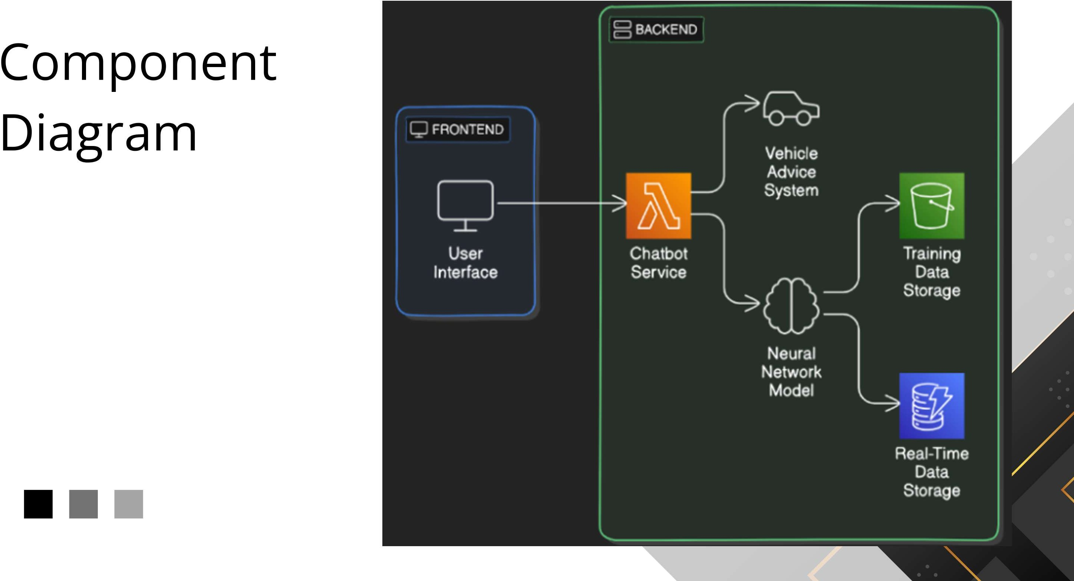

Slide 30

Data ColJection
Data was collected from mechanics, vehicle experts, and customer feedback, covering vehicle specifications, maintenance, and user preferences. This diverse dataset ensures accurate and personalized advice.

Slide 31
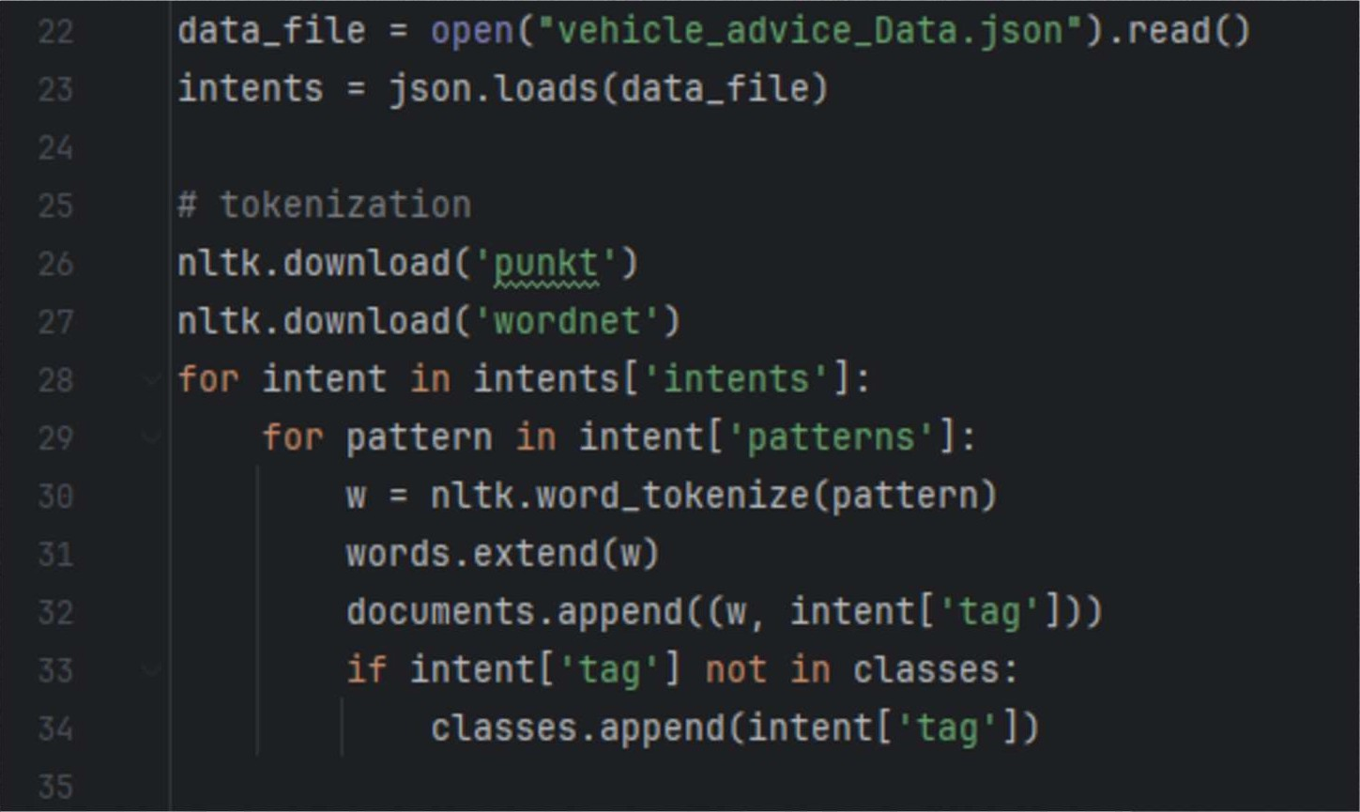

Data Preprocessing
Data Loading acd Tokenization
vehicle-related queries and intents were gathered and stored in vehicle advice Data.json.

Slide 32
Data Preprocessing
Lemmatization and Bag of Words Creation

Slide 33
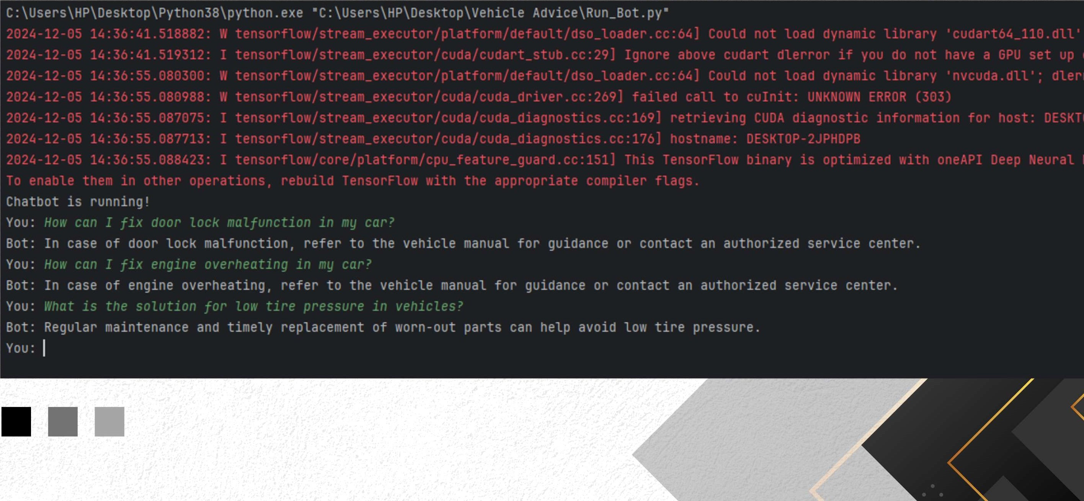
Running Chatbot

Slide 34
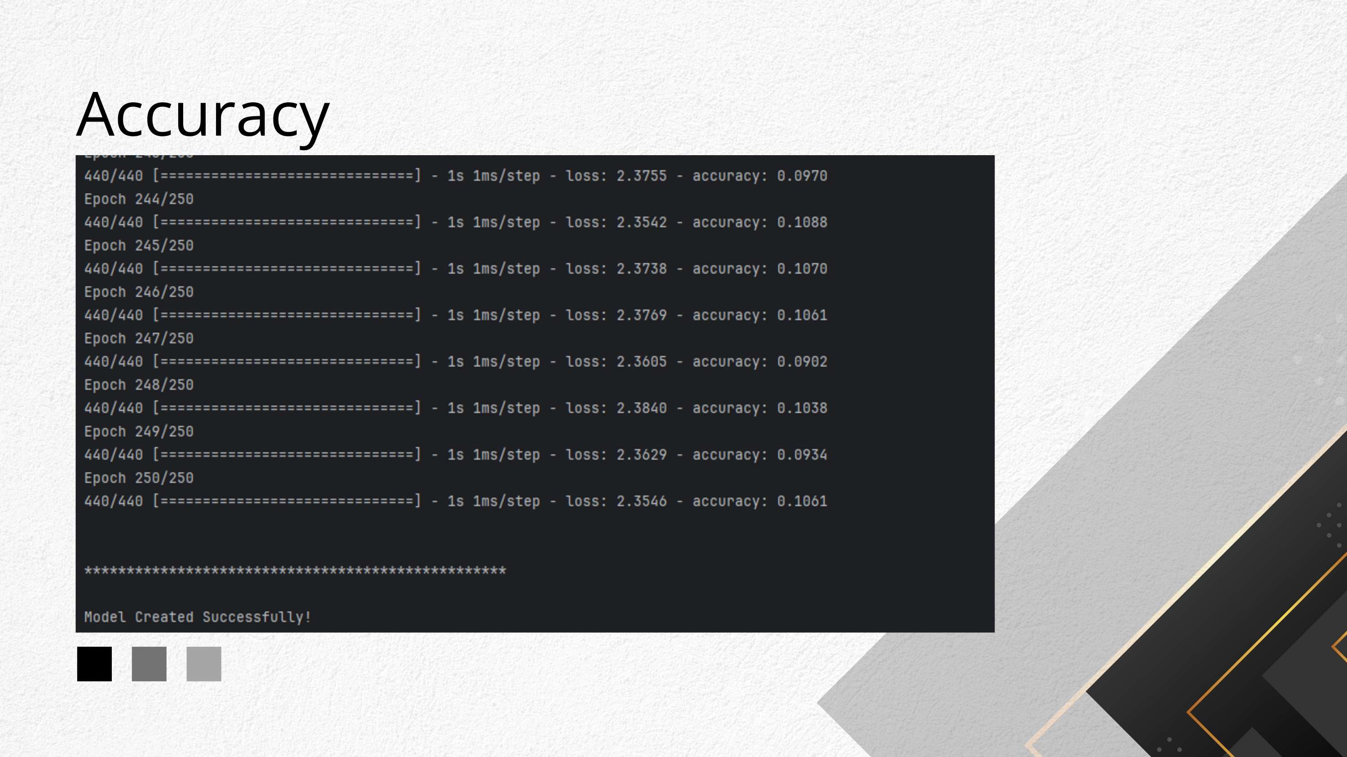

Slide 35
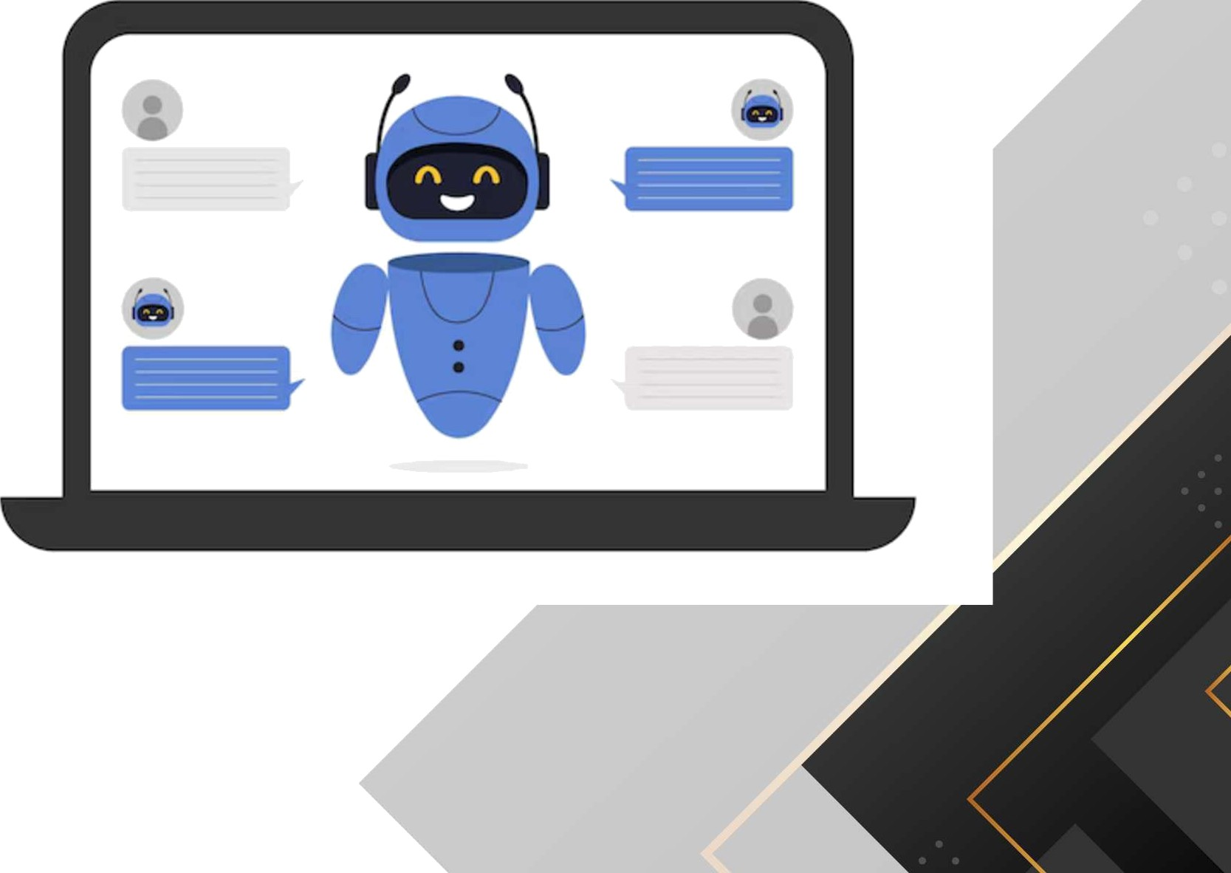
Work Completion
Data Collection
Data Preprocessing
Model Building
Chatbot Development
Testing and Optimization

Slide 36
Future Checklist
Data Collection and Enrichment
User Interface and Experience
Monitoring and Maintenance
Performance and Scalability

Slide 37
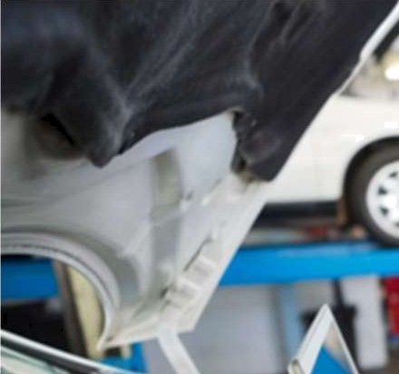

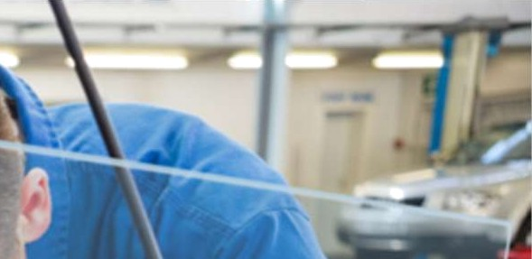


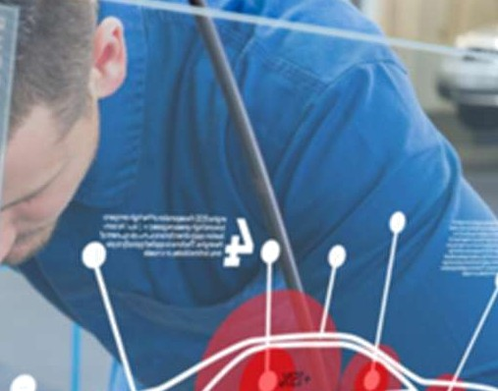

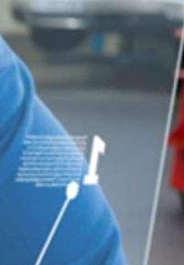



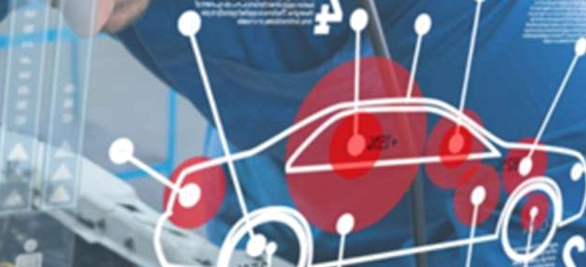






Provide personalized automobile part
recommendation G.P.D.P.Nanayakkara
(IT21 1 59862
•In the rapidly evolving automobile industry, providing personalized recommendations for automobile parts is crucial for enhancing customer satisfaction
Aspects
Data Collection Introduction
NLP Implementation
Sentiment Analysis.
Recommendation System Development
System Testing

Slide 38

Research Probiem
How can we develop a system that accurately
recommends automobile parts based on individual preferences and experiences as captured through customer reviews and
feedback?

Slide 39
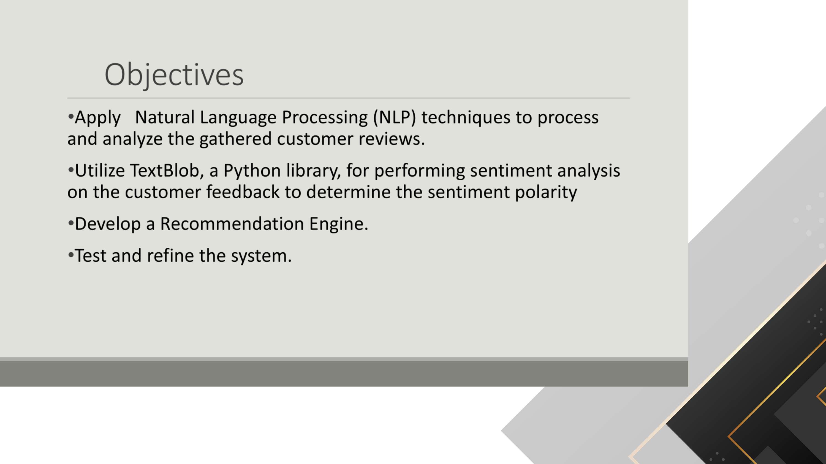

Slide 40


Sub-Objectives
Design and implement the architecture for a neural network-based chatbot.
Train the chatbot on a comprehensive dataset
of vehicle-related information, including
customer preferences and scenarios.
Integrate the chatbot seamlessly into a personalized vehicle advice platform.
Create an intuitive, user-friendly interface for
seamless interaction with the chatbot.
Evaluate and refine the chatbot to improve its accuracy, responsiveness, and user satisfaction through iterative testing.

Slide 41































Research Gap
Application REF
IoT Integration for vehicle Data
Personalized Part Recommendation
Prediaive Mainenence Integration
Eco- Friendty2Sustainability Focus
Real-Time Data Analysis
Research 1
(2021)
ScholarsEdge
Research 2
(2020)
Research 3
(2018)
Proposed System

Slide 42
Technologies
Programming Language: Python Frameworks/Libraries: TensorFlow, PyTorch, Pandas, Numpy, SciPy, Scikit-learn, Flask, spaCy, NLTK Hardware: ESP32 Modules, Sensors
Protocols: HTTP/HTTPS
APIs: Google Maps API, Firebase, Google Cloud IoT
Tools: Arduino IDE, Pycharm
Database : Firebase

Slide 43
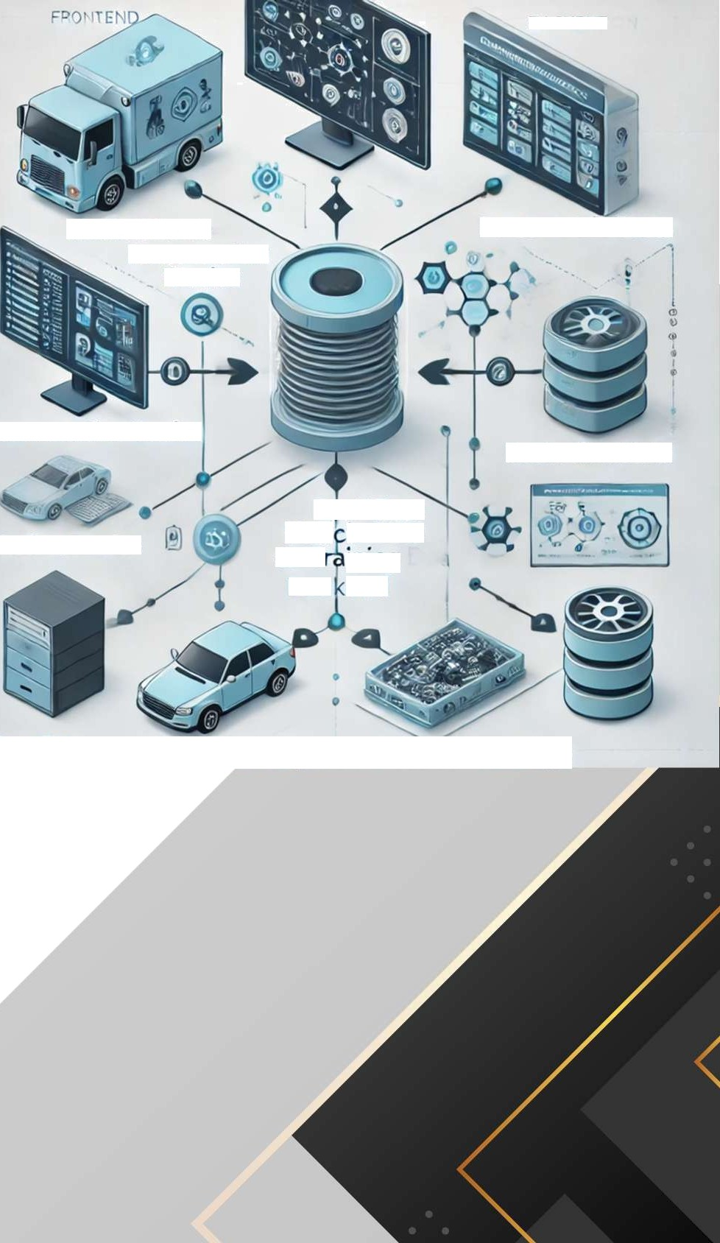















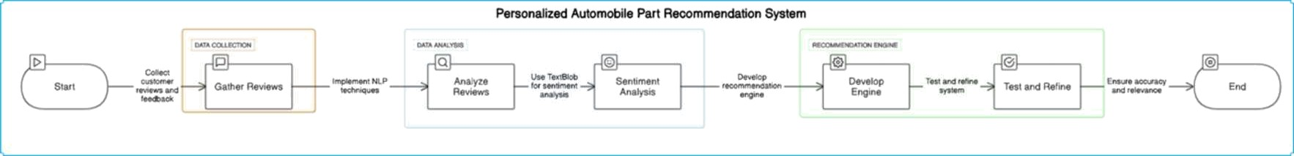
BAC1¢E II”
Chatbot Sc vic
Reoma«ation
Service
Partomotćle Parts
Recotmenation Service
Recin-tìme Daa
Réal-lme Vehi le Da4a & Ti ining
Bac end
Chatbot Service
^{F}’°
UN'
Training Data Storage
Reálæ Òæôa SØrage

Slide 44

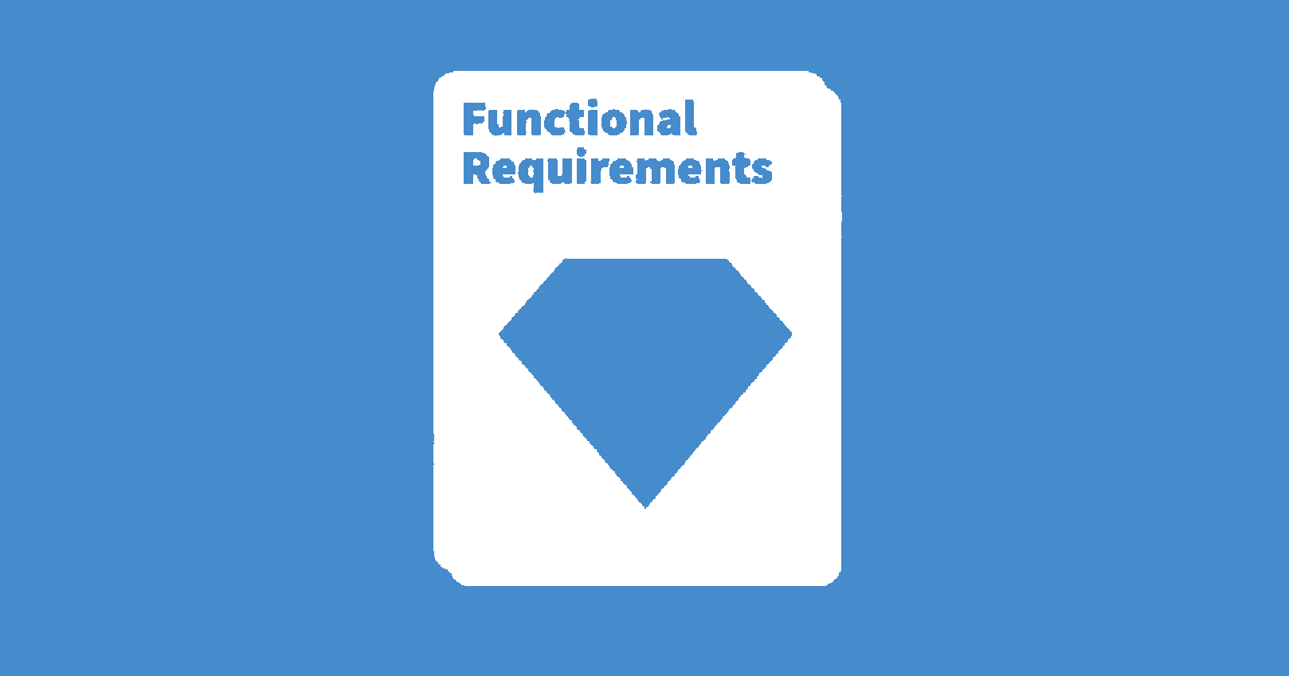
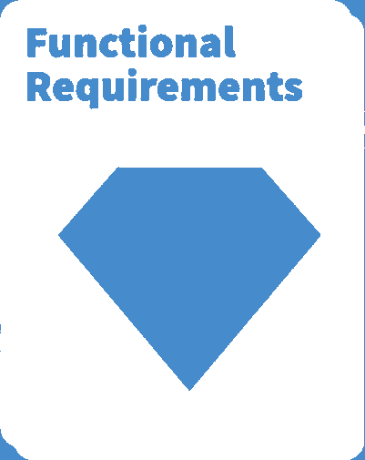
Functional Requirements
Process user queries and identify intent.
Generate personalized vehicle advice.
Handle vehicle data for accurate recommendations.
Provide real-time responses via a user-friendly interface.

Slide 45
Non-FunctionaJ Requirements
Performance: The chatbot should respond to user queries within 2 seconds
to ensure smooth interactions.
Scalability: The system should handle increasing user interactions without
performance degradation.
Reliability: Ensure high availability with minimai downtime for consistent
user experience.
Usability: Provide a simple, intuitive interface for users of varying technical
expertise.
Security: Safeguard user data and interaction logs to maintain privacy and data integrity.

Slide 46
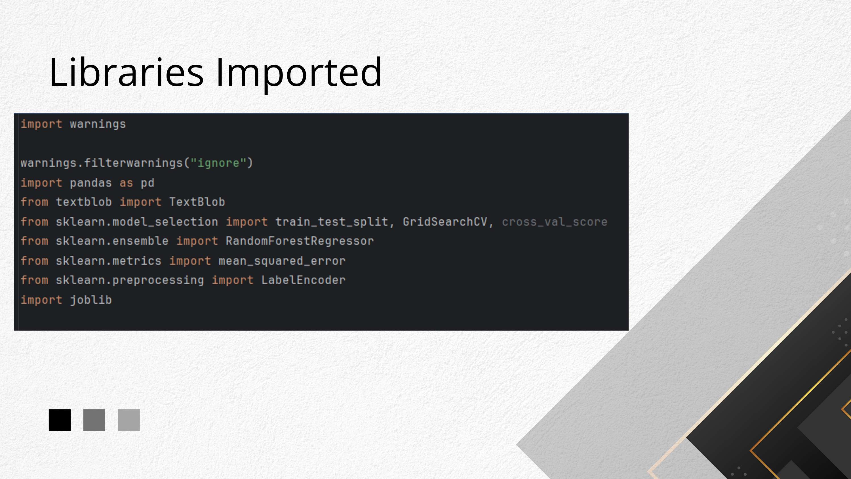

Slide 47
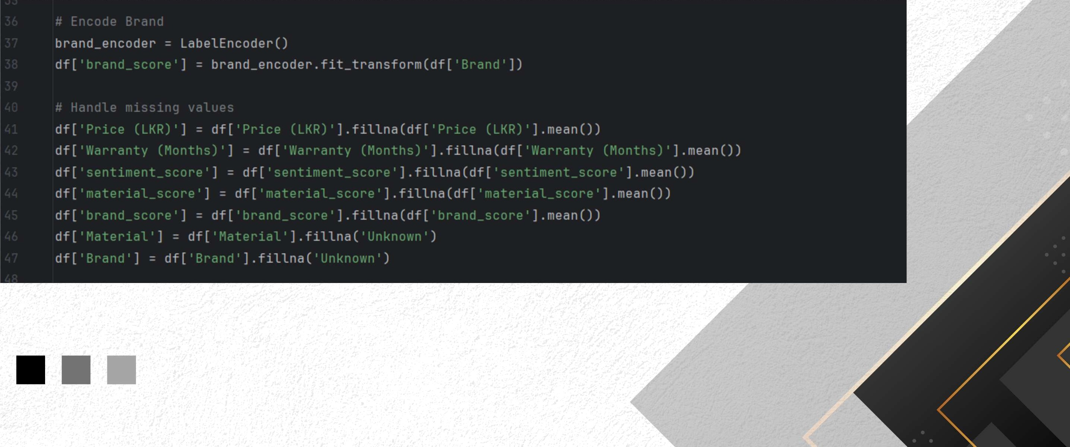
Data Preproccesing

Slide 48
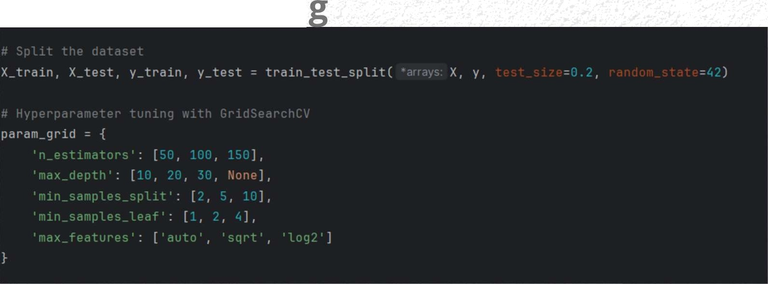
Modeİ Buiìding
Model Architecture
- ),
Model Compilation and Trainin

Slide 49
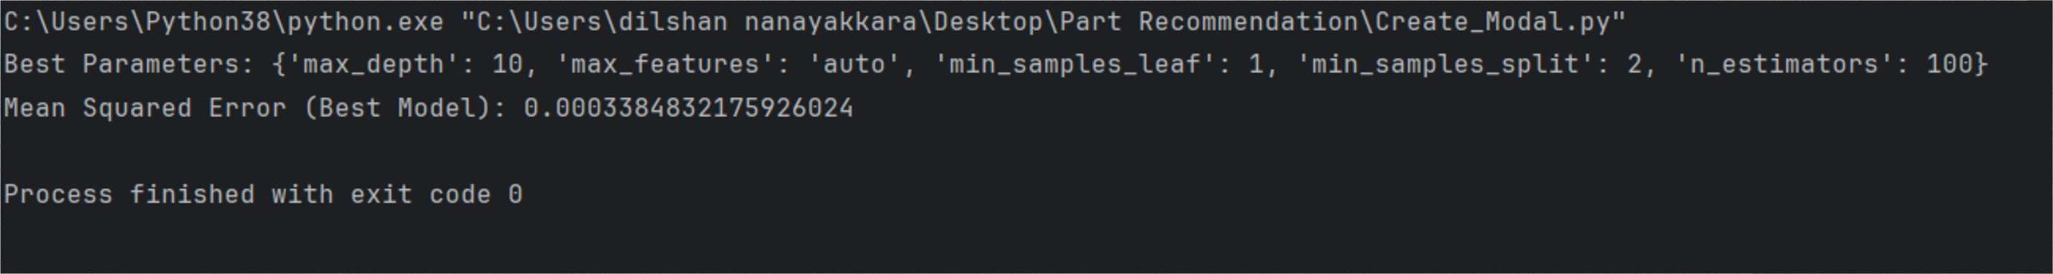
accuracy output
95% accuracy

Slide 50


